Slide 1
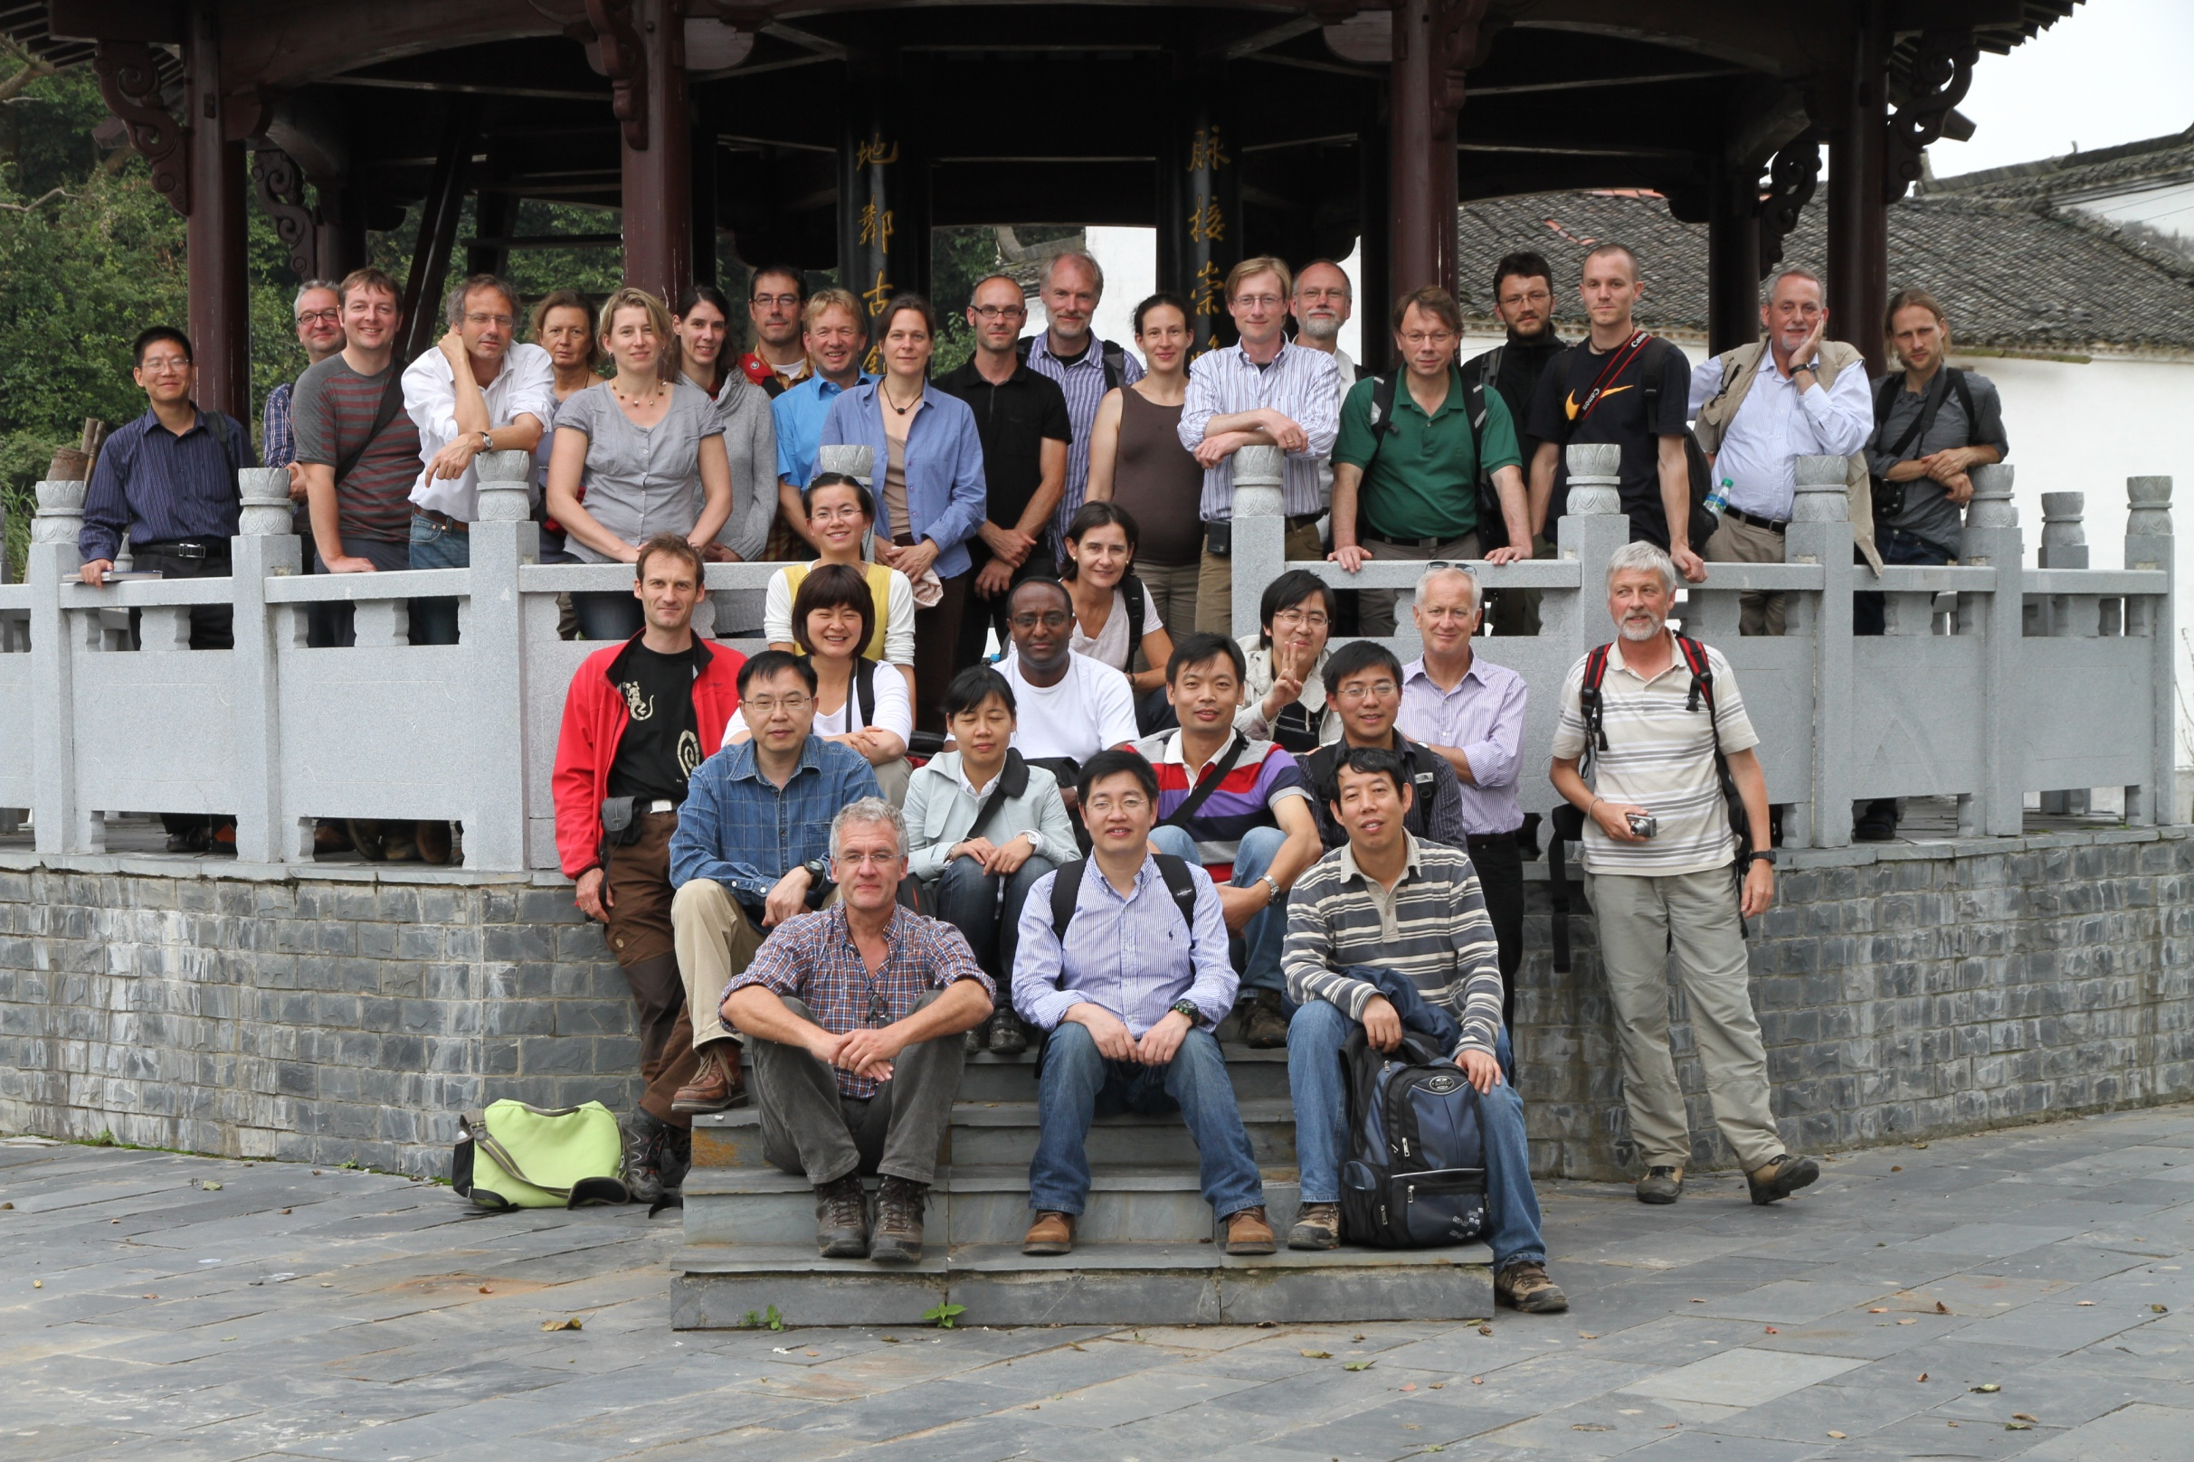
P 11 Invasion
Alexandra Erfmeier
P 9 Plant Insect
Alexandra-Maria Klein
P 3 Traits
Erik Welk
P 13 Microbes
Jessica Gutknecht
P6 Soil
Christian Geißler
P4 genetics
Stefan Michalski
Gutianshan Nature Reserve
Teng Fang
P 4 Genetics
Walter Durka
P 6 Soil
Thomas Scholten
P8 Herbivores
Thorsten Assmann
P8 Herbivores
Andreas Schuldt
P 6 Soil
Peter Kühn
Z 2 Data
Karin Nadrowski
P 2 Demography
Werner Härdtle
P7
Francois Buscot
P 4 genetics
Markus Fischer
P2
Goddert von Oheimb
P 5 nutrient dynamics
Michael Scherer-Lorenzen
Z1 coordination
Lin Chen
Z1
Yuanjie Xu
Z1, P11
Xuefei Yang
P 7 soil microbes
Tesfaye Wubet
P5
Zhiyao Tang
P8 Herbivores
Hongzhang Zhou
Z1
Fan Zhu
Z1, Z2, P3, P11
Helge Bruelheide (speaker)
P 3 Traits
Shouren Zhang
P5
Jinsheng He
P8 Herbivores
Xiaodong Yu

